Slide 1
API Work
W4d4 June27

Slide 2
Today
Fill out checkin
Note your Partner
Put you in a breakout room
One of you make a repo on github
Add your partner as a collaborator
Add me as a collaborator
Decide on the data source for your project
Pull your data and see what you’re dealing with
No need to clean but just know what youre working with – how messy is it?

Slide 3
Check-in
https://forms.gle/6PZZVVNrNjuBsVCM8

Slide 4
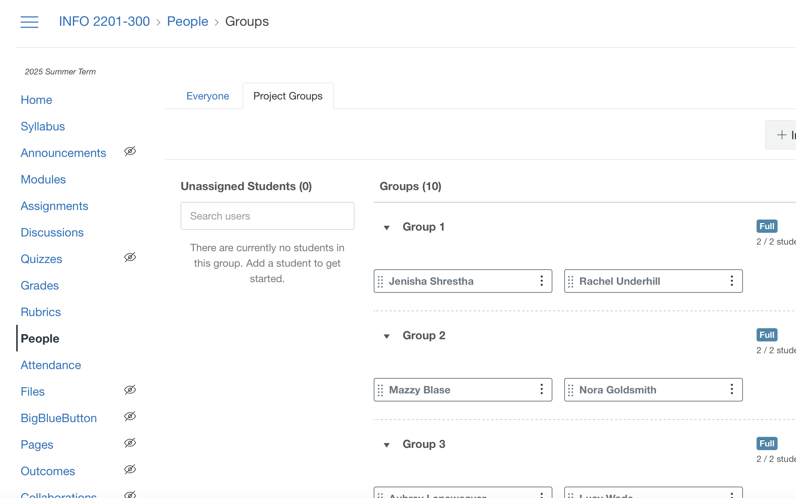
Note your Partner

Slide 5
On GitHub
Make a Repository
Add your partner as a collaborator
Add me as a collaborator

Slide 6
Decide on a Data Source for your Project
What we’ve worked with so far:
http://clerk.house.gov
https://www.songlyrics.com
https://www.nytimes.com
https://pokeapi.co
https://api.tvmaze.com/
http://ws.audioscrobbler.com/2.0/
https://developer.nps.gov/api/v1
https://en.wikipedia.org/w/api.php
YOU DON’T NEED TO USE ANY OF THESE FEEL FREE TO PICK YOUR OWN

